Slide 1

Data Analysis in Security Assignment Part Two
Maciej Kasztelewicz
Kacper Moll
Eliot Van Goethem
Pietro Lodi Rizzini

Slide 2

What is the goal of the project?
During the work we analysed the network traffic simulated in the laboratory for educational purposes and captured by Wireshark as .pcap files. The raw data was then extracted as a .csv file and analysed with Jupyter Notebook. The provided analysis focused on:
the search for unusual behaviour
structure of the network traffic

Slide 3
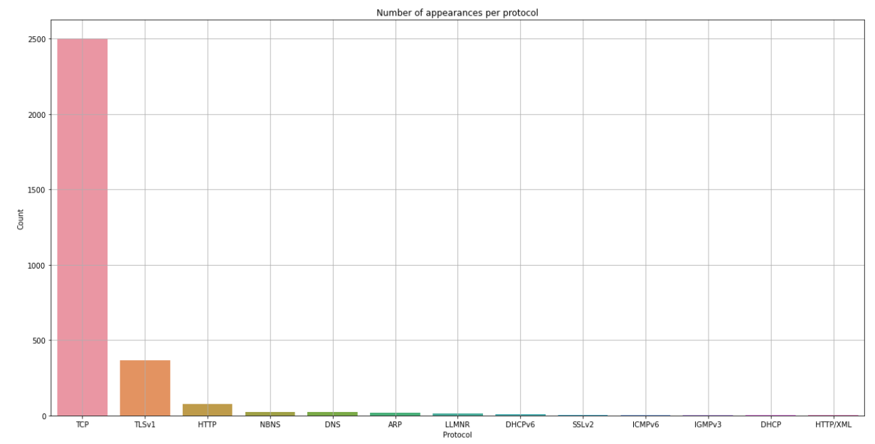
Protocol and Protocol Hierarchies

Slide 4
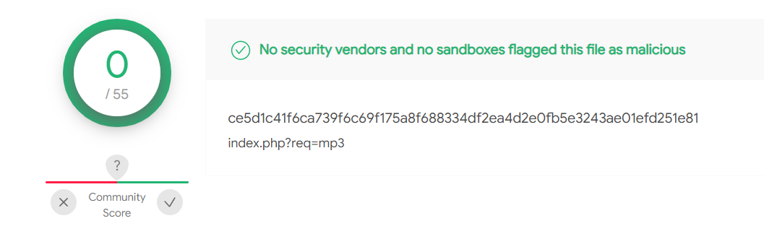
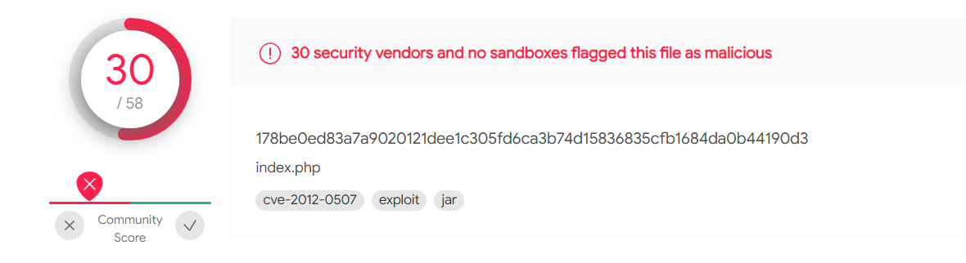
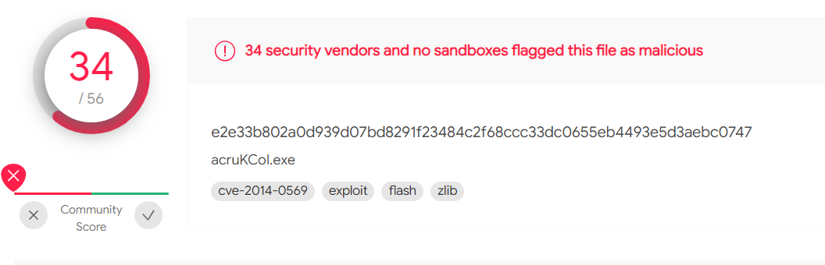
Files downloaded by user
Wireshark enables us to get hashes of the files downloaded by the user. Software such as VirusTotal helps with the analysis of whether the file is infected or not.

